Slide 1
Kibana and Microsoft Azure ML Studio Tutorial
Michael Brumwell, Christian Rodriguez,
Mario Arguello, Brianne Phillips
Notes:
Font size 24

Slide 2
Kibana and Data Setup

Slide 3
Kibana and Data Setup:
Step 1: Download the hc_flu_vaccination csv data
Step 2: Open Kibana and select Machine Learning (between Maps and Infrastructure) on the Right-Side toolbar
Step 3: Under “Import Data” Select Upload File. Drag the data file to the Kibana Screen and confirm the data.
Step 5: Create a new index for the data. Give it the name flu_hospital.
*This lab assumes you are using the client version of Kibana and that you know how to run it
Notes:
Now that we have uploaded and indexed our data, we will be able to use it for the following visualizations.

Slide 4
Create Visualizations

Slide 5
Creating a Bar Graph:
Step 1: Click on Visualizations in the right toolbar, then select Vertical Bar Graph. The indexed dataset will be the flu_hospital index
Step 2: Under Metrics, look at the fields under Y-Axis and ensure the following fields are set correctly:
Aggregation is set to Count
Y-Axis has custom label of Number of Clinics (the Y axis will represent the total number of clinics)
Notes:
For our Bar Graph we will be looking at the top 5 clinics with vaccinated personnel by county. We will only be using a select number of clinics in order to make the graphs look neat and easy to find the data we’re looking for.

Slide 6
Creating a Bar Graph:
Step 3: Look at the Buckets section under Metrics and click add. A menu appears with 3 sections, select X-axis.
Step 4: Ensure the following for the X-axis:
Aggregation - Terms (“-“ ---> is set to)
Field - County
Order By - Metrick: Number of Clinics
Order - Descending
Size - 5
Notes:
Now we are going to organize our data into buckets.
The X-axis is what we’re going to use to divide our clinics by county. For the Fields of our new X-axis ensure the following:

Slide 7
Creating a Bar Graph:
Step 5: To include the percentage of vaccinated personnel do the following:
Under X-axis, click ADD then click Split Series
Sub aggregation - Terms
Field - HCP_Percent_Vaccinated
Order By - Metric: Number of Clinics
Order - Descending
Size - 5
Custom Label - Percent Personnel Vaccinated
Save as Flu-Hosp Bar Graph
Notes:
Now we currently have a bar graph with a Y-axis showing the number of clinics and the X-axis separated by top 5 counties with the greatest number of clinics. To include the percentage of vaccinated personnel we will do the following:

Slide 8
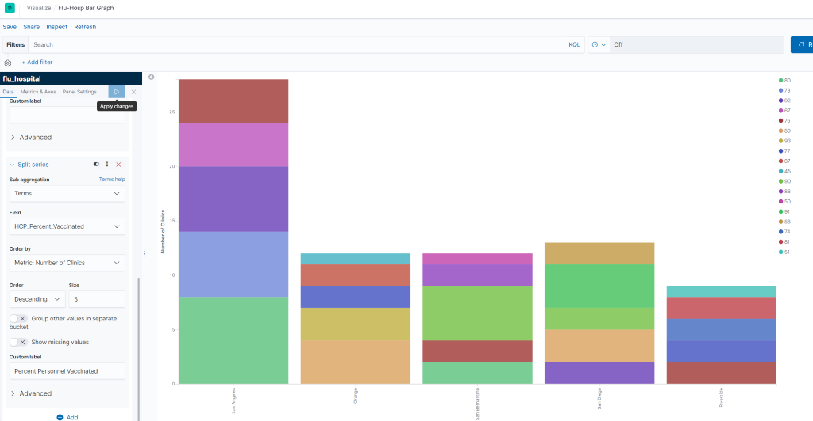
Notes:
Results should look like this

Slide 9
Creating a Pie Graph:
Step 1: Under Metrics block, ensure the following:
Under Slice Size
Aggregation is set to Count
Custom label set to Number of Clinics
Under Buckets
Aggregation - Terms
Field - County
Order By - Metric: Number of Clinics
Order - Desc
Size - 7
Custom Label - Number of County Clinics
Notes:
For this pie graph, we are going to check the clinics with the lowest 5 percentage of vaccinated personnel using our hospital index

Slide 10
Creating a Pie Graph:
Step 2: Create a new sub-bucket using the Split Slices option
Aggregation - Terms
Field - HCP_Percent_Vaccinated
Order By - Metric:Number of Clinics
Order - Ascending
Size - 5
Custom Label - Personnel Vaccinated (%)
Save the graph as Percent Vaccinated Personnel by County
Notes:
Now we have a slice with a single ring, representing the top 7 counties with the most number of flu clinics. Now we are going to further visualize our data to determine the clinics with the least amount of vaccinated personnel. To finish visualizing the data, we are going to do the following:

Slide 11
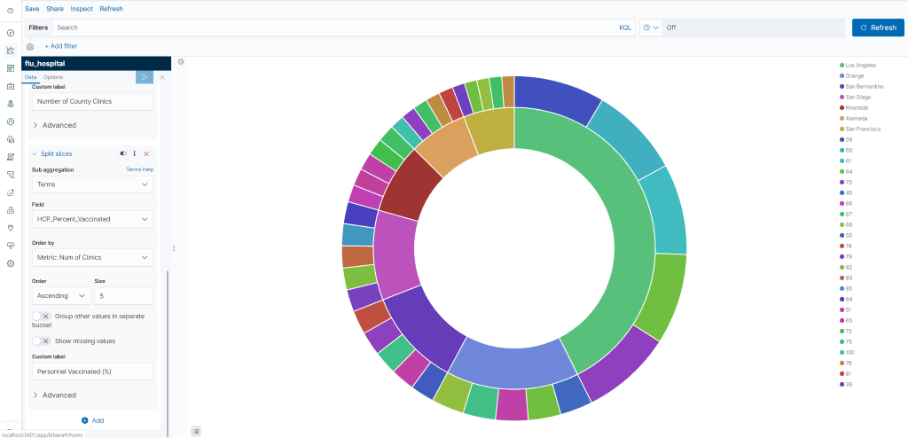
Notes:
Results should look like this

Slide 12
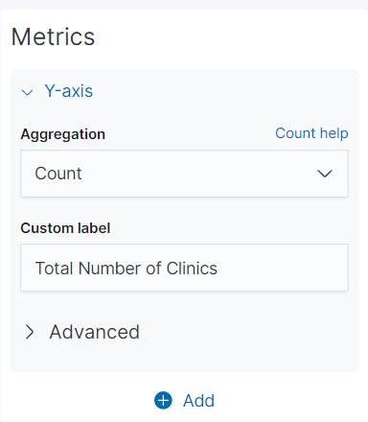
Creating Bar Graph 2:
Step 1: Create a new Vertical Bar Graph using the hospital index
Step 2: Under Y-axis, sent the following
Aggregation - Count
Custom Label - Total Number of Clinics
Notes:
Create a new Vertical Bar Graph using the hospital index

Slide 13
Creating Bar Graph 2:
Step 2: Click ADD button below Y-axis and click X-axis, then set the following:
Aggregation - Terms
Field - County
Order By - Metric:Number of Clinics
Order - Descending
Size - 5
Custom Label - County
Save the graph as Percent Vaccinated Personnel by County
Notes:
Now we separate our clinics by county by doing the following:

Slide 14
Creating Bar Graph 2:
Step 3: Further organize data by separating the chart into parts
Add new sub-bucket and click Split Chart
In row that says Rows and Columns, select Rows
Sub aggregation - Terms
Field - On Track To Achieve 90% by 2020
Order By - Metric: Total Number of Clinics
Order - Ascending
Size - 5
Notes:
In order to further determine clinic eligability, we need to further organize our data by seperating the chart into parts.

Slide 15
Creating Bar Graph 2:
Step 4: Split to see percentage of people vaccinated
Create Split Series sub-bucket
Sub aggregation - Terms
Field - HCP_Percent_Vaccinated
Order By - Metric: Total Number of Clinics
Order - Descending
Size - 5
Save the graph as clinics_on_track bar graph
Notes:
Now we have our graph separated by county, and separated into 3 graphs separated by yes, no, and ‘DNR’ but we still want to see the percentage of people that have been vaccinated.

Slide 16
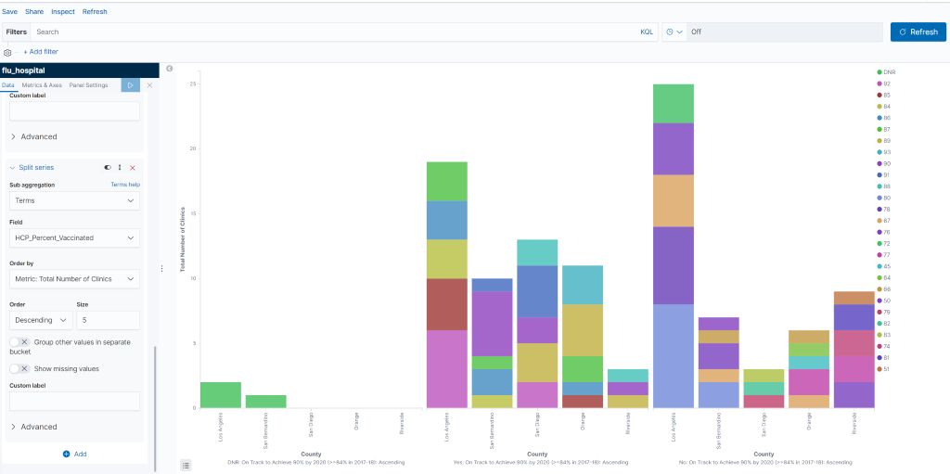
Notes:
Results should look like this

Slide 17
Creating a Dashboard:
Step 1: Click the dashboard icon on the left toolbar in Kibana, click add to create a new dashboard. A list will appear with existing visualizations.
Step 2: Click the three that were just created and save as Hospital Dashboard.
Notes:
Now that we have our 3 graphs, we can use kibana to organize them in a dashboard for easy access.

Slide 18
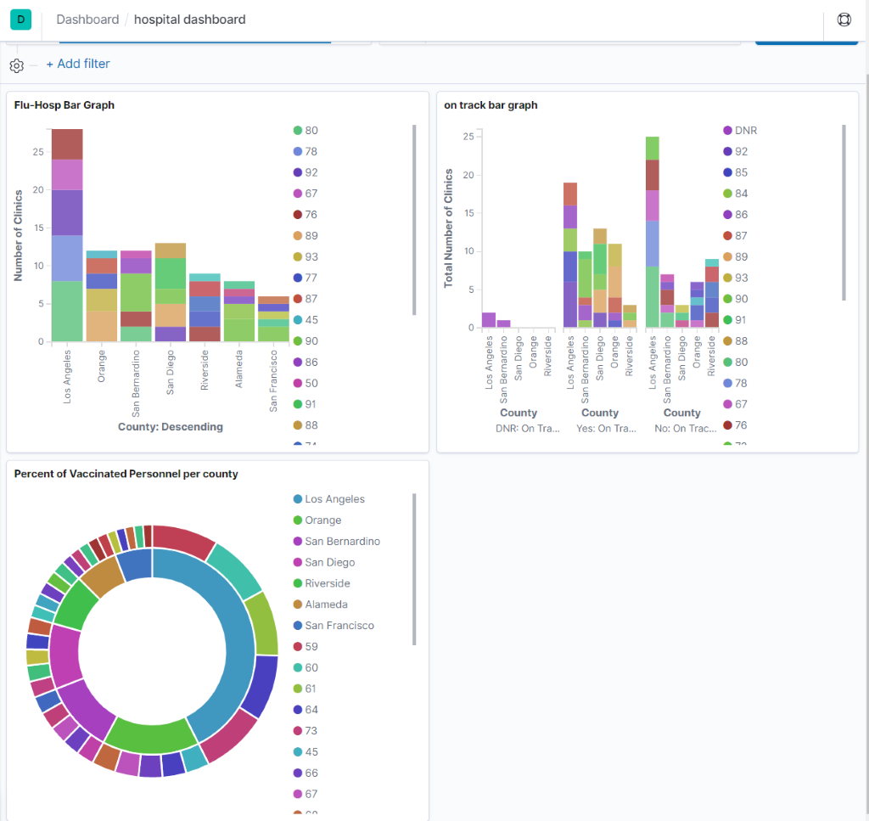
Notes:
Results should look like this

Slide 19
Creating a Geospatial Map with Excel:
Step 1: Open the data in Excel.
Step 2: Highlight the data by left-clicking the first field of the first column and dragging it until every record is highlighted.
Step 3: In top left corner, select Insert, then Maps, then Filled Maps
Now a map of California will appear with clinic locations, but we need to remove some extra data
Notes:
Because the data we are using doesn’t contain geo hash coordinates, we are unable to create a coordinate map using Kibana. Since the data includes county names in California, we can use that data to create a map of California.

Slide 20
Creating a Geospatial Map with Excel:
Step 4: Right click the map and select Select Data
Step 5: In the left box, remove Facility_name and Facility_ID
Step 6: Name the map “Vaccinated Personnel by County” where it says Chart Title

Slide 21
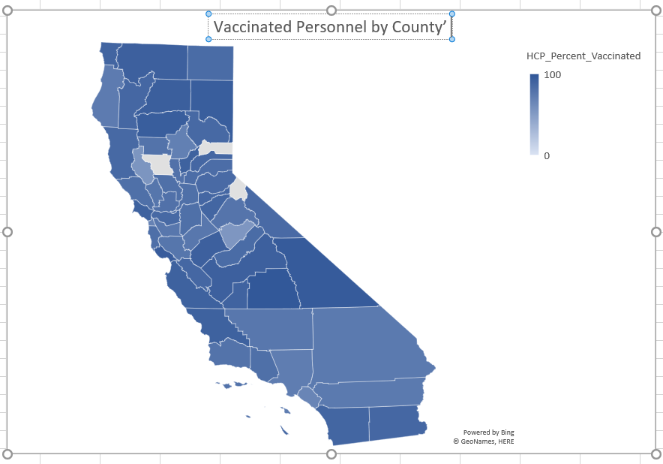

Slide 22
End of ElasticSearch Kibana Tutorial

Slide 23
Microsoft Azure ML Studio Using Bayesian Linear Regression

Slide 24
Overview:
In this tutorial you will know how to create an experiment, load the data set provided, and use regressions to calculate evaluations levels with Microsoft Azure Machine Learning Studio software. Our project consists of patient flu vaccinations from hospitals in every county of California.
This tutorial is focused for students at beginner level.

Slide 25
What You’ll Need:
To complete this tutorial, you will need:
Microsoft Azure Machine Learning Studio with a created account by clicking the website https://studio.azureml.net/
You need to download the HCP Flu Vaccination data set by clicking this link https://data.ca.gov/dataset/health-care-personnel-influenza-vaccination
Web browser with internet connection.

Slide 26
Create an Azure ML Account :
By clicking the link above you will be able to log in or create an account in Azure.
Once logged into your Azure account, add the pre-downloaded file from the previous slide into second data set called HCP Influenza Vaccination by Hospital and County.
After you downloaded it the data set should look like the following: (next slide)

Slide 27
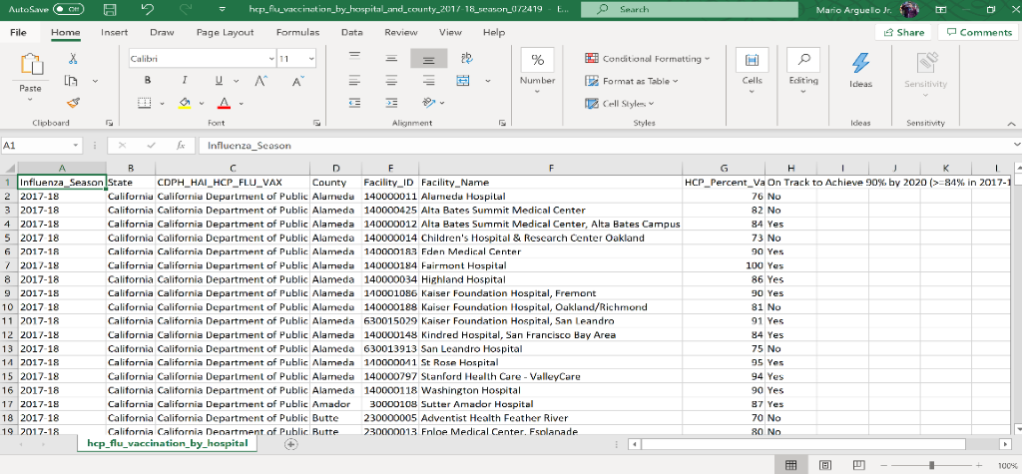

Slide 28
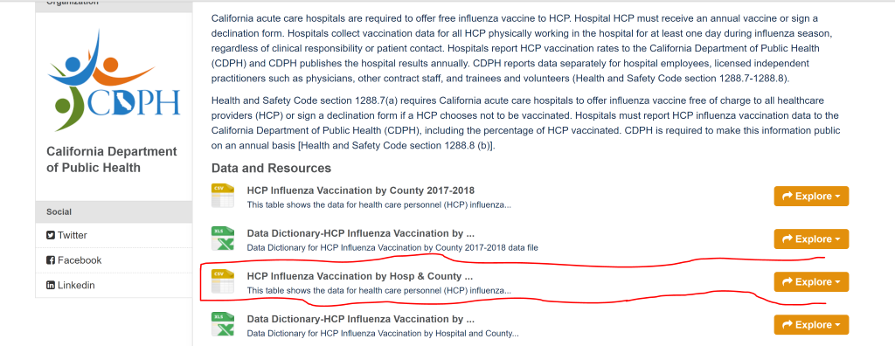

Slide 29
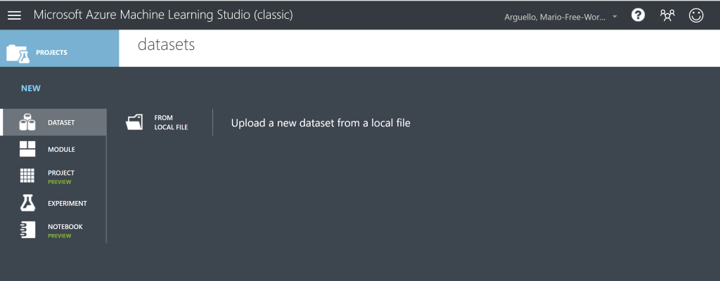
Create an Experiment and Add Modules:
Let’s start by clicking on DATASET and click new data set located on the bottom left. Then click form local file to retrieve the data set HCP Flu Vaccination from which you saved it in.

Slide 30
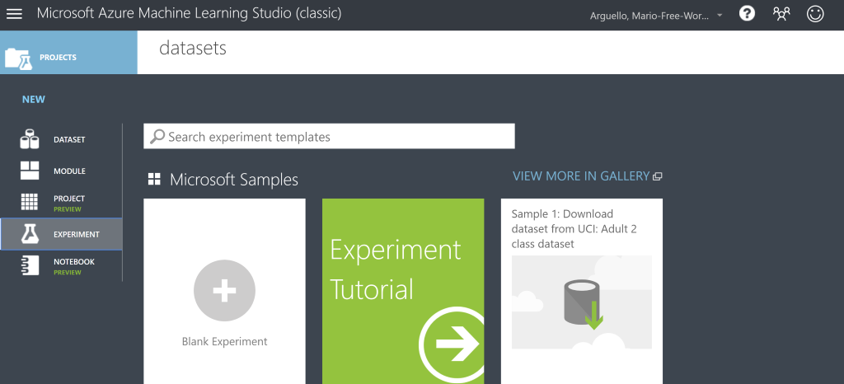
After the data set is uploaded you need to create a new experiment by clicking on EXPERIMENT and Blank Experiment.

Slide 31
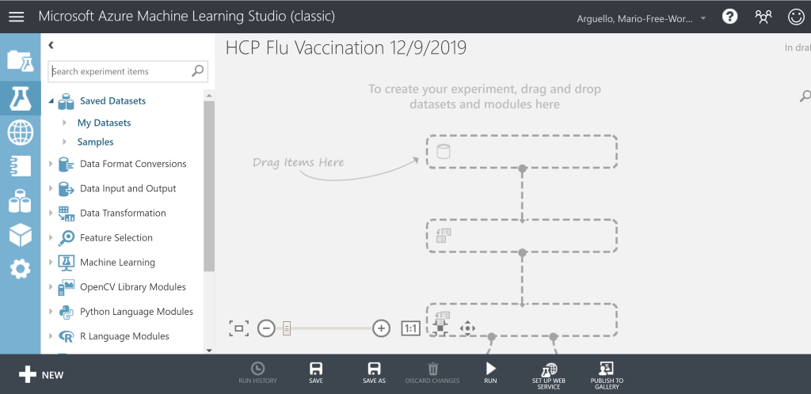
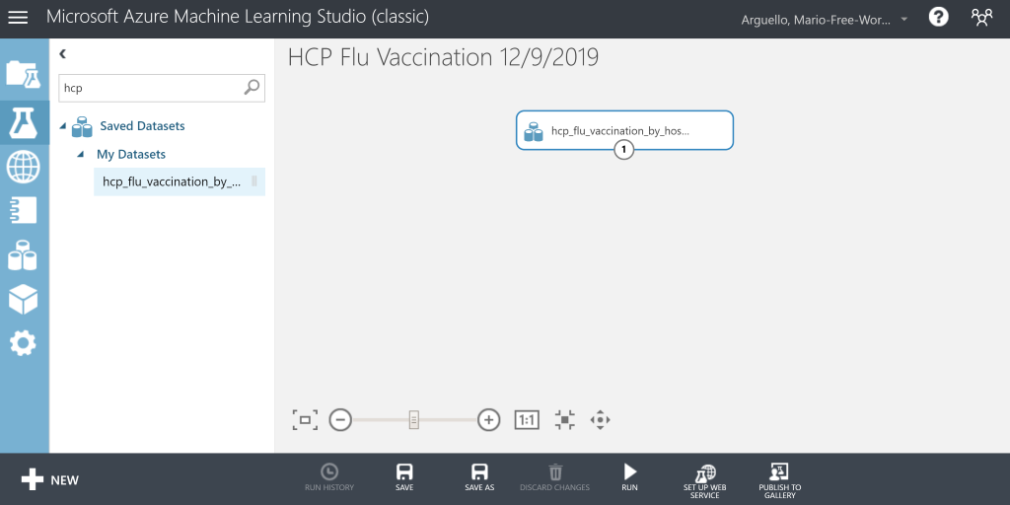
Uploading a Data File to Azure ML:
Name the experiment - HCP Flu Vaccination. Now search HCP Flu Vaccination on the top left search bar and drag the data set module to the center. Your work should resemble the images below.

Slide 32
Creating an Azure ML Experiment:
Next, search Select Columns in Data Set and drag it to the center. Launch the column selector and click By Name and select County, Facility Name, and HCP_Percent_Vaccinated. Connect the HCP flu data to the Select Columns Data Set. Make sure to save and run the experiment. The modules should resemble the following pictures.

Slide 33
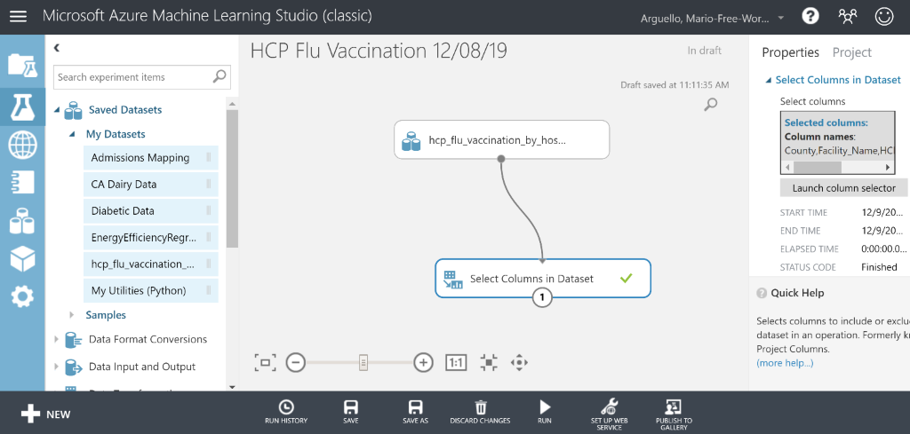

Slide 34
Now search for Split Data and drag to the center. At the properties pane under Split Data, adjust the following; splitting rows: Split Rows, fraction of rows: 0.5, random speed: 0. Under Train Model at properties, launch column selector and click with rules and search HCP_Percent_Vaccinated. Click the check box on the properties pane.
Connect from the Select Columns Data Set to the Split Data module.

Slide 35
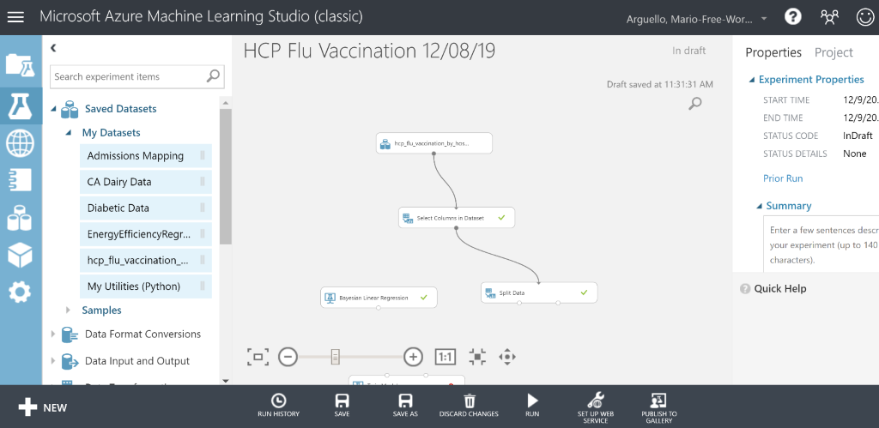
Now search Bayesian Linear Regression and drag it to the center. At the properties pane on the right make sure that the regularization weight is 1 and check the box on allow unknown.
Always make sure to save.

Slide 36
Next, search Train Model module and drag it. Under Train Model at the properties pane, launch column selector and click with rules and search HCP_Percent_Vaccinated. Then connect the Bayesian Linear Regression module to the left dot of the Train Model. Now connect Split Data to the Train Model. Save and Run the experiment.

Slide 37
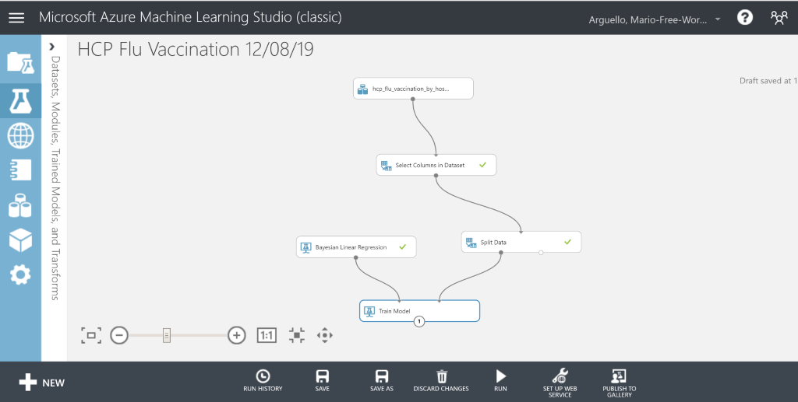
Examine the Data

Slide 38
Now, right click Split Data and click on dataset 1 and visualize. Do this with the data set 2. You will see some cool insights of the percentage of the patients who got vaccinated in the flu season of 2017-2018.
These insights show the county names and the names of the hospitals where the patients were vaccinated. Also the percentage. You are almost done with this tutorial. Refer to the images below for accuracy.

Slide 39
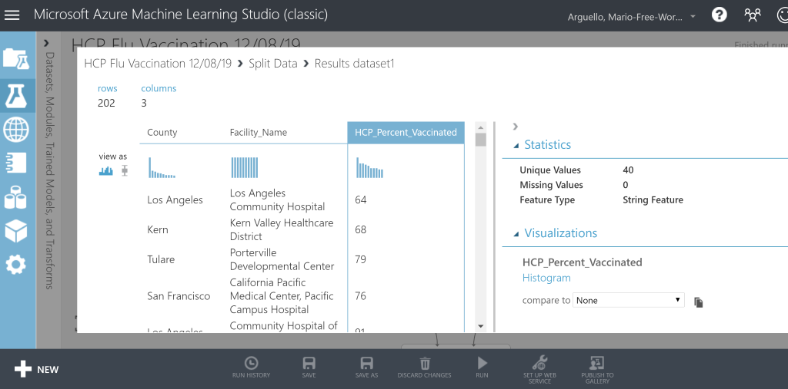
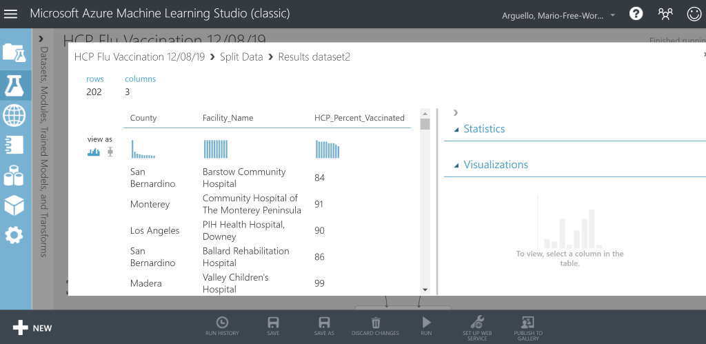

Slide 40
Now search Score Model and drag it to the center. Then search Evaluate Model and drag it to the center.
Connect the Train Model module to the Score Model. Then connect the right dot of Split Data to the Score Model.
Lastly, connect the Score Model module to the Evaluate Model module. The experiment should resemble the image below.
Save and run the experiment. You should see check marks every time you save and run.

Slide 41
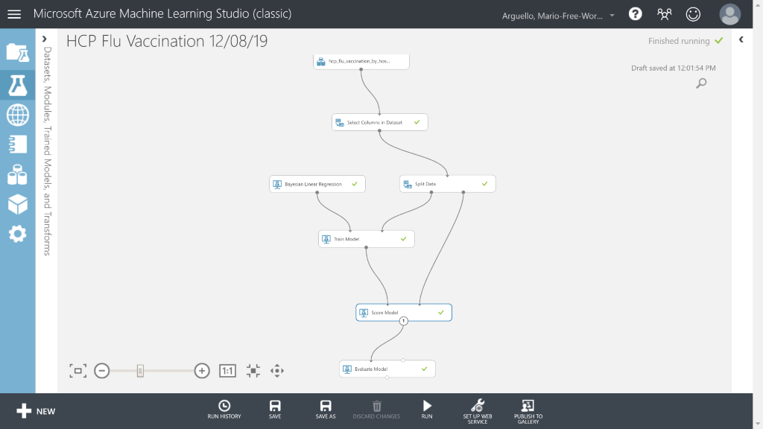
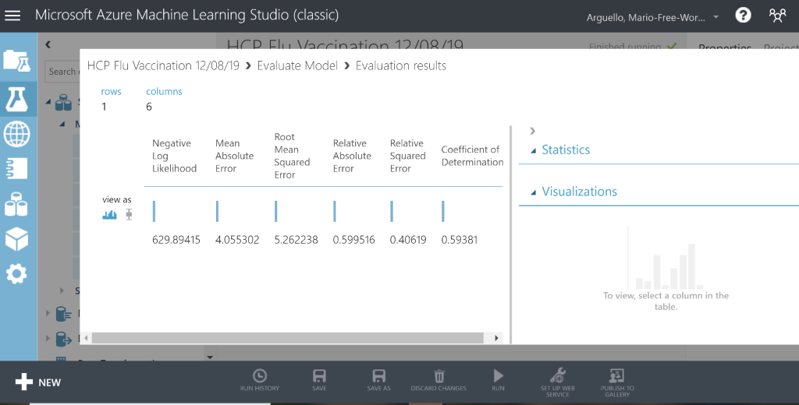

Slide 42
Right click the Evaluate Model module and scroll to evaluation results and click Visualize. You will see the evaluation results of the linear regression of the percentages of patients who were vaccinated in the hospitals of every county in California. This shows the margins of the statistics of this data set. You can see that there are root mean errors squared and relative absolute error. They have the numbers in decimal.
This concludes the tutorial of this project on Microsoft Azure Machine Learning Studio.

Slide 43
Summary:
In this tutorial you have learned how to use Microsoft Azure at a beginner’s level. You also learned on how to upload the data set provided to this software tool. You also learned how to modify the properties pane to filter our this data set. The purpose of this tutorial project is to learn Bayesian linear regression models and using score and train models to obtain insights of evaluation results when the model is running.

Slide 44
References:
https://data.ca.gov/dataset/health-care-personnel-influenza-vaccination
California Department of Public Health Influenza Vaccination Data Set
https://data.ca.gov/dataset
California Department of Public Health open data website
https://docs.microsoft.com/en-us/azure/machine-learning/studio-module-reference/bayesian-linear-regression
Bayesian Linear Regression Concept

